Slide 1
Climate Change: Underlying Science and Producer Adaptations
Eugene S. Takle
Professor
Department of Agronomy
Department of Geological and Atmospheric Science
Director, Climate Science Program
Iowa State University
Ames, IA 50011
Practical Farmers of Iowa
Harlan, IA
11 September 2010

Slide 2
Climate change is one of the most important issues facing humanity
The scientific evidence clearly indicates that our climate is changing, and that human activities have been identified as a dominant contributing cause.
Don Wuebbles
Notes:
No disagreement in peer reviewed literature
Powerful statements from every major professional science society and organization in the world
Powerful statements from the National Academies of Sciences (the leadership in science) for every major country
G8 + 5 other countries, May 2009: “The need for urgent action to address climate change is now indisputable.”

Slide 3
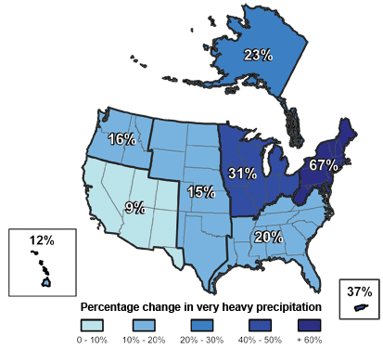
Climate changes are underway in the U.S. and are projected to grow
Temperature rise
Sea-level rise
Increase in heavy downpours
Rapidly retreating glaciers
Thawing permafrost
Lengthening growing
season
Lengthening ice-free season
in the ocean and on lakes
and rivers
Earlier snowmelt
Changes in river flows
Plants blooming earlier; animals, birds and fish moving northward
Don Wuebbles

Slide 4
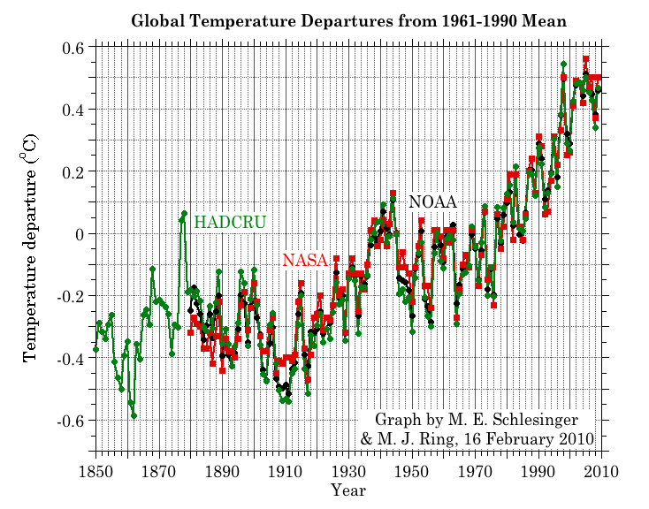
Three separate analyses of the temperature record – Trends are in close agreement
Don Wuebbles

Slide 5
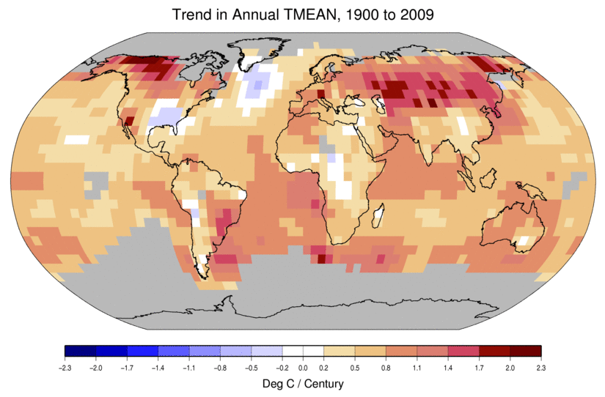
Temperature Changes are Not
Uniform Around the Globe
From Tom Karl, NOAA NCDC

Slide 6
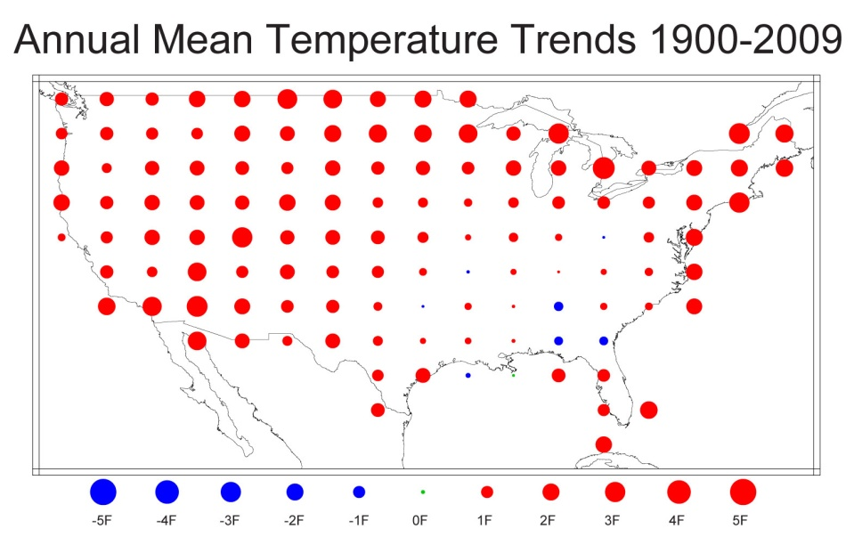
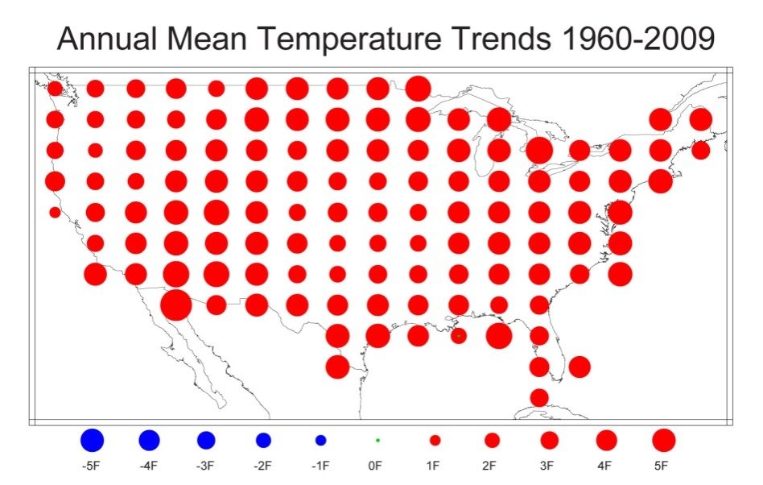
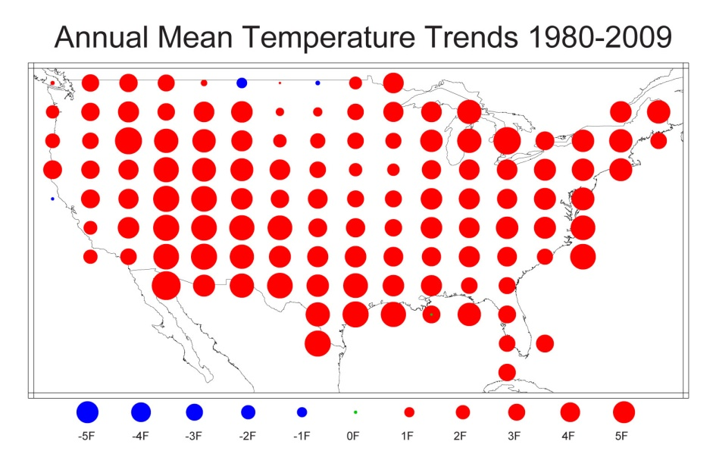
U.S. Temperature Trends
U.S. average temperature has risen more than 2ºF over the past 50 years
From Tom Karl, NOAA NCDC

Slide 7
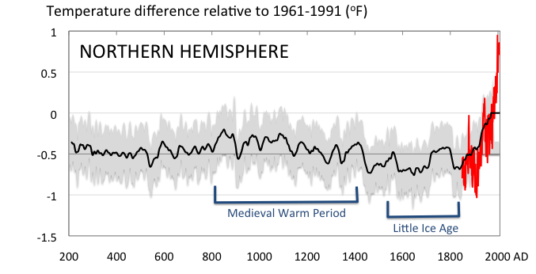
Conditions today are unusual in the context of the last 2,000 years …
Don Wuebbles

Slide 8
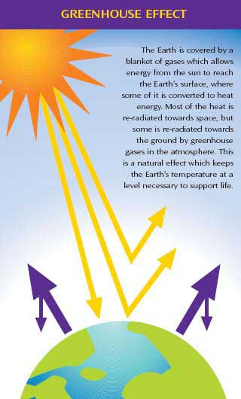
Why does the Earth warm?
1. Natural causes
THE GREENHOUSE EFFECT…
…is 100% natural.
  Heat is trapped in the atmosphere.
…sustains life on Earth.
  Keeps average temperatures at 12.8ºC (55ºF), instead of –29ºC (-20ºF).
Don Wuebbles

Slide 9
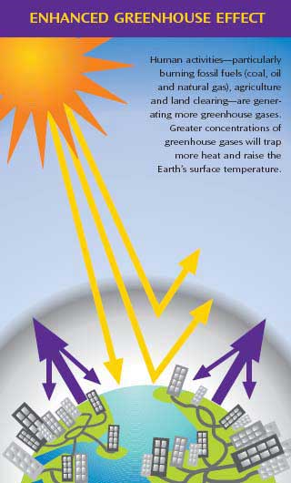
Why does the Earth warm?
2. Human causes
THE ENHANCED GREENHOUSE EFFECT
(or GLOBAL WARMING)
… is primarily human-induced: We’re increasing heat-trapping gases in the atmosphere.
… is like wrapping an extra blanket around the Earth.
Don Wuebbles

Slide 10
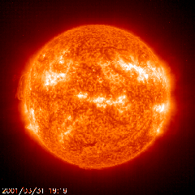
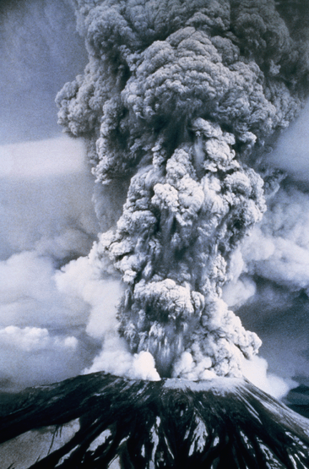
Natural factors affect climate
Variations in the energy
received from the sun
Variations in the Earth's orbit
(Milankovic effect)
Stratospheric
aerosols from
energetic
volcanic eruptions
Chaotic interactions in
the Earth's climate
(for example, El Nino, NAO)
Don Wuebbles

Slide 11
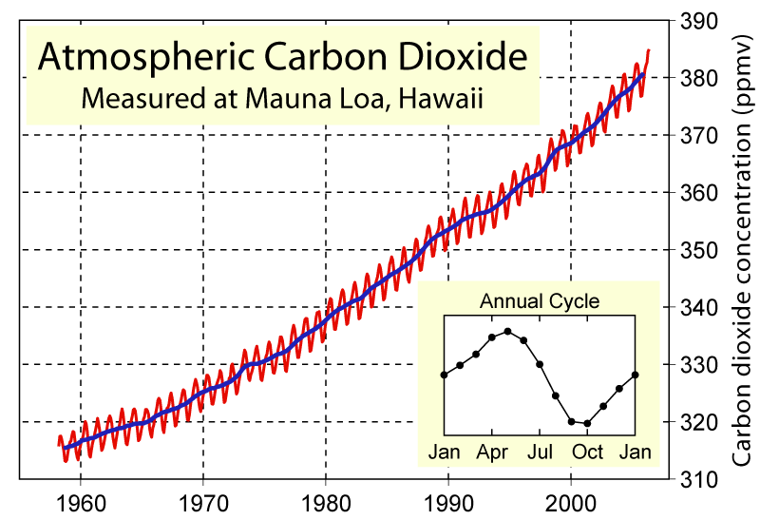
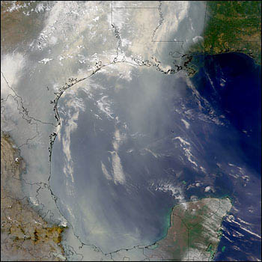
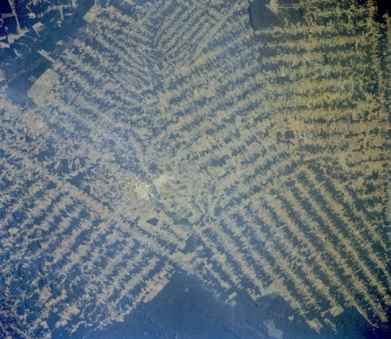
Non-natural mechanisms
Changes in atmospheric concentrations of radiatively important gases
Changes in aerosol particles from burning fossil fuels and biomass
Changes in the reflectivity (albedo) of the Earth’s surface
Don Wuebbles

Slide 12
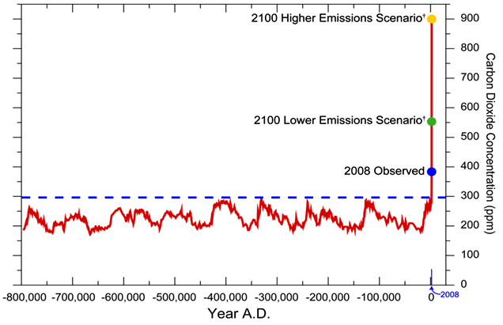
We have Moved Outside the Range of Historical Variation
800,000 Year Record of Carbon Dioxide Concentration
Don Wuebbles

Slide 13
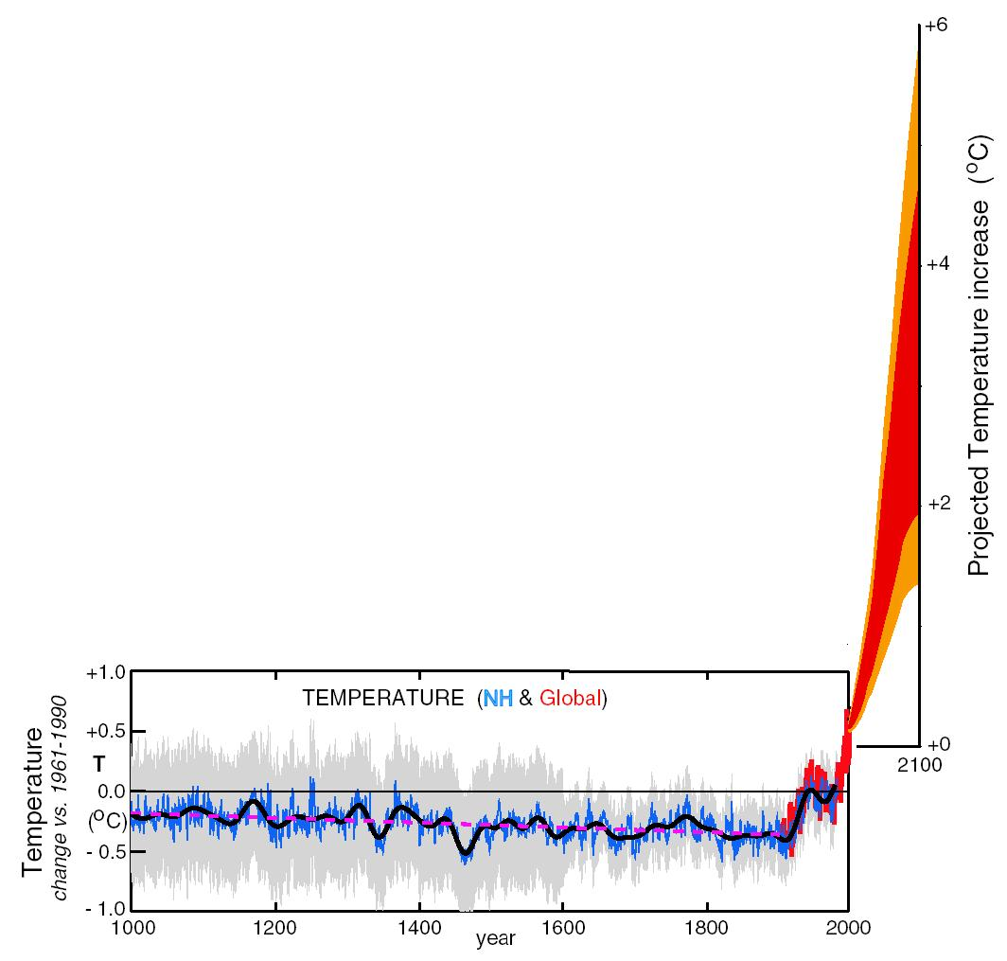
What can we expect in the future?
Don Wuebbles

Slide 14
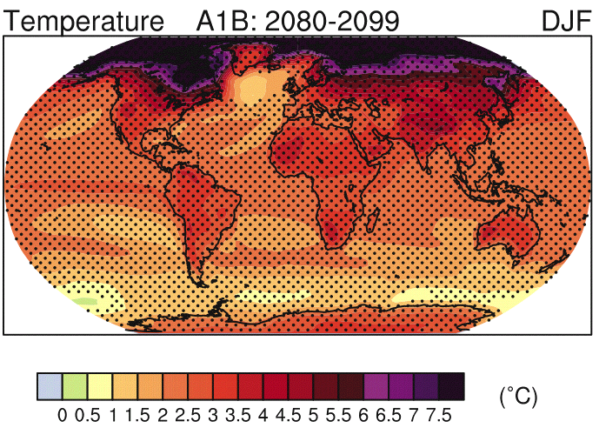
IPCC 2007

Slide 15
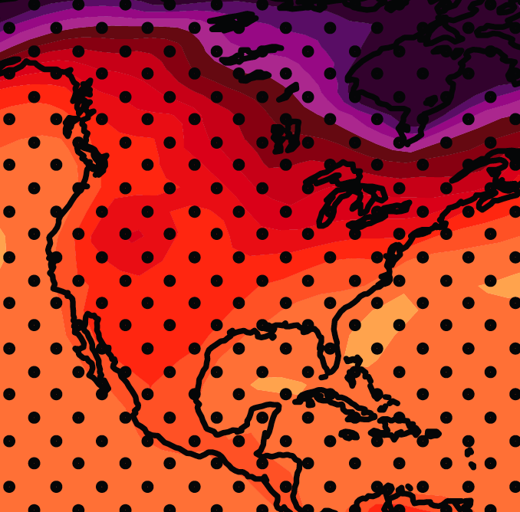
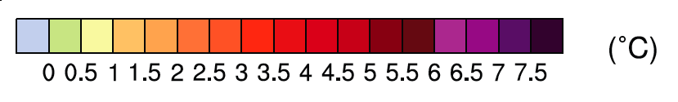
December-January-February Temperature Change
7.2ºF
6.3ºF
A1B Emission Scenario
2080-2099 minus1980-1999

Slide 16
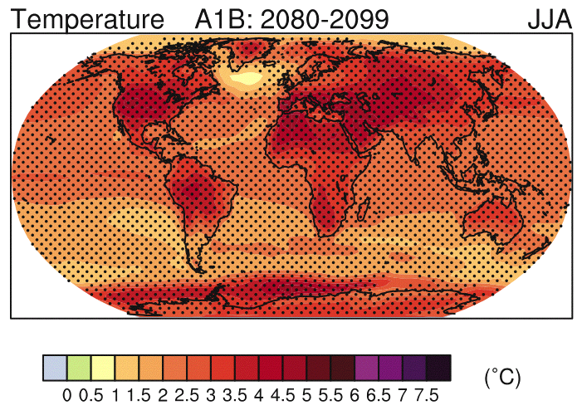
IPCC 2007

Slide 17
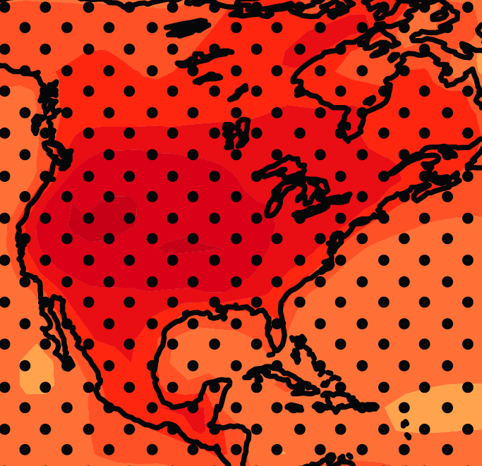
June-July-August Temperature Change
4.5ºF
5.4ºF
A1B Emission Scenario
2080-2099 minus1980-1999

Slide 18
June-July-August Temperature Change
4.5ºF
5.4ºF
A1B Emission Scenario
2080-2099 minus1980-1999
Not the direction of current trends

Slide 19
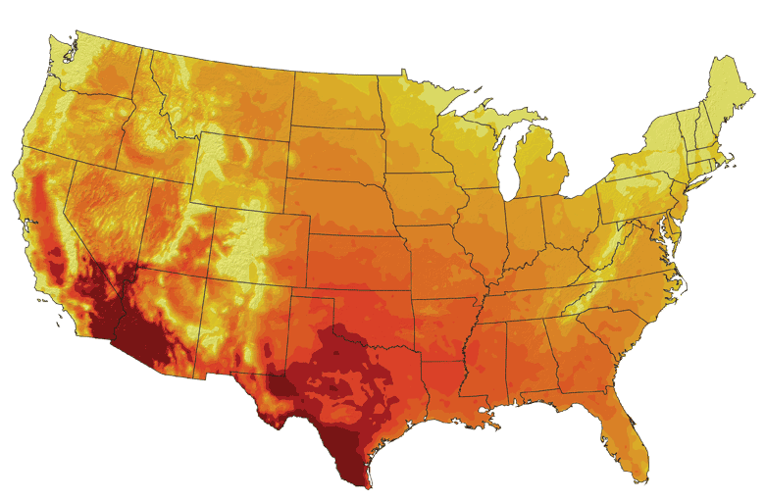
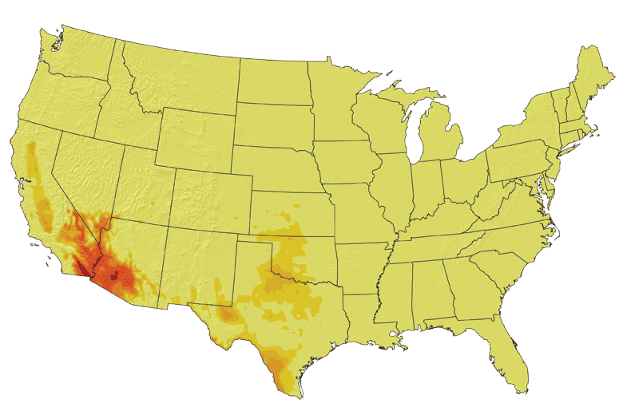
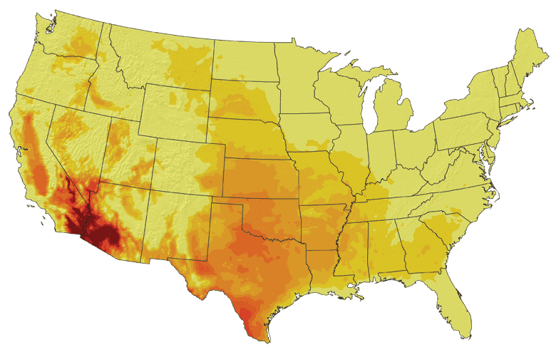
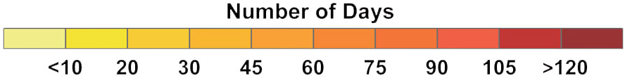
Increases in very high temperatures will have
wide-ranging effects
Higher Emissions Scenario, 2080-2099
Number of Days Over 100ºF
Recent Past, 1961-1979
Average:
30-60 days
Lower Emissions Scenario, 2080-2099
Average:
10-20 days
Don Wuebbles

Slide 20
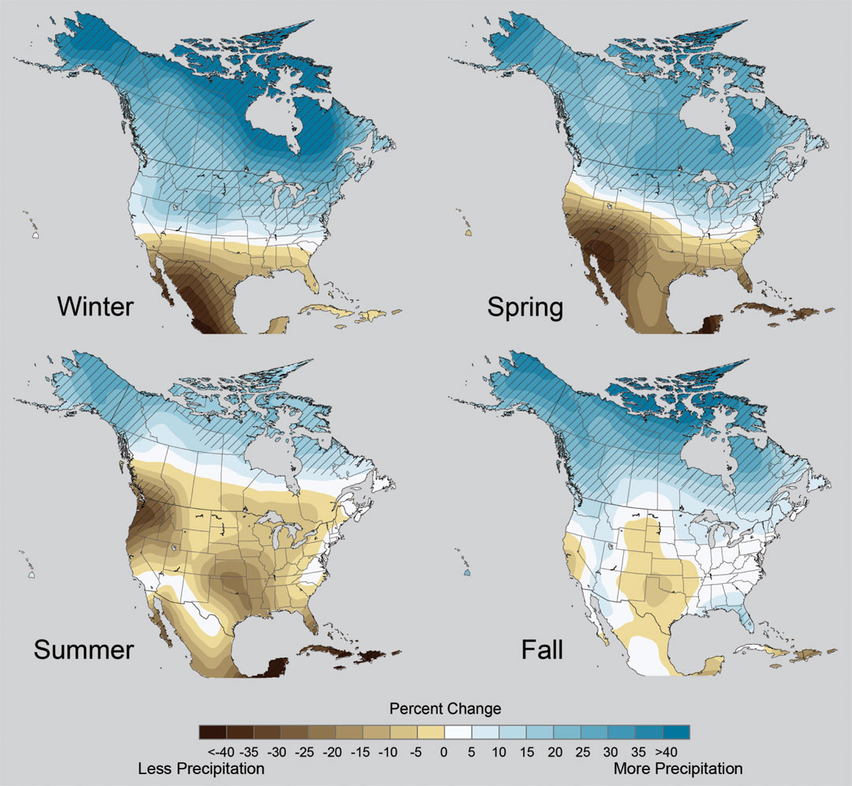
Projected Change in Precipitation: 2081-2099
Midwest: Increasing winter and spring precipitation, with drier summers
More frequent and intense periods of heavy rainfall
Unstippled regions indicate reduced confidence
Relative to 1960-1990
NOTE: Scale Reversed
Don Wuebbles

Slide 21
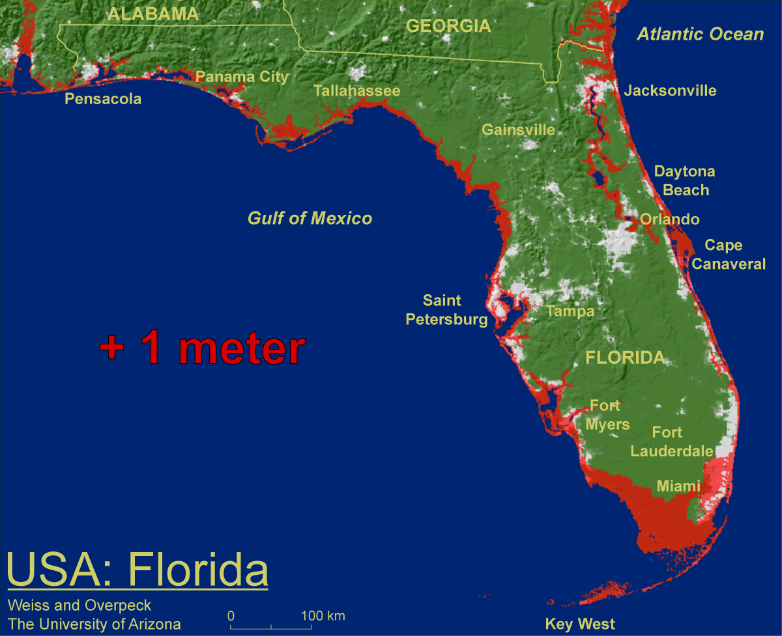
1 meter will be hard to avoid, possibly within this century, just from thermal expansion and small glacier melt.
Don Wuebbles

Slide 22

Widespread climate-related impacts are occurring now and are expected to increase
Water Resources
Energy Supply & Use
Transportation
Agriculture
Don Wuebbles
Ecosystems
Human Health
Society

Slide 23
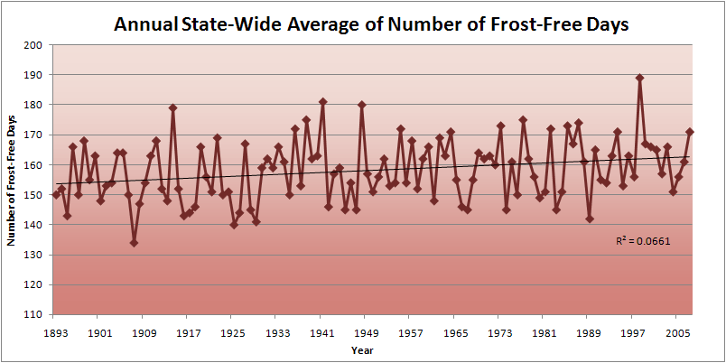
Iowa State-Wide Average Data

Slide 24
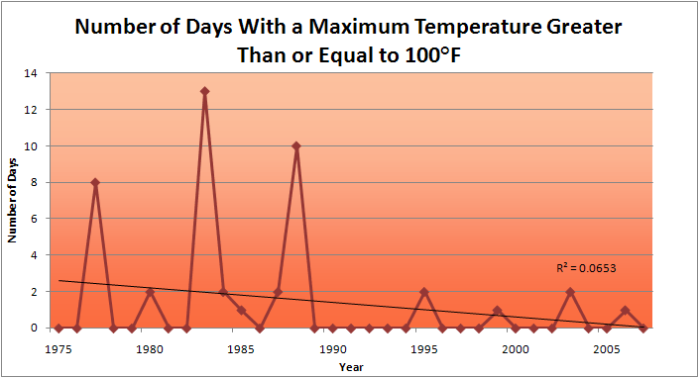
Des Moines Airport Data
1983: 13
1988: 10
1977: 8
2009: 0

Slide 25
Des Moines Airport Data
1983: 13
1988: 10
6 days ≥ 100ºF in the last 20 years
1977: 8
2009: 0

Slide 26
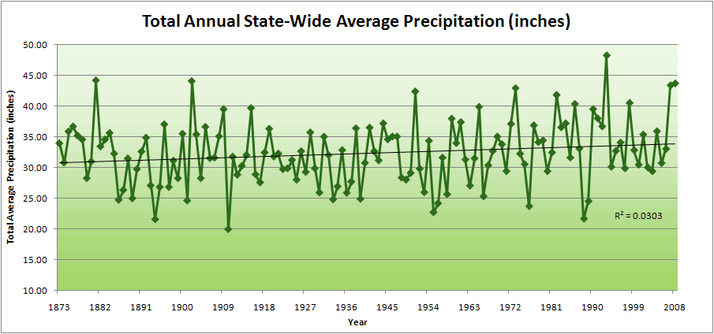
Iowa State-Wide Average Data

Slide 27
Iowa State-Wide Average Data
34.0”
8% increase
31.5”

Slide 28
Iowa State-Wide Average Data
Totals above 40”
2 years

Slide 29
Iowa State-Wide Average Data
Totals above 40”
8 years
2 years

Slide 30
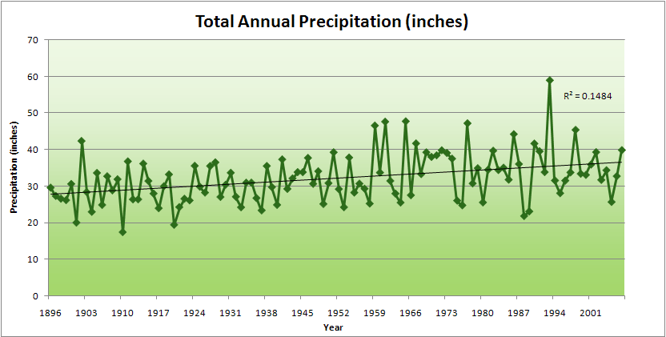
Cedar Rapids Data

Slide 31
Cedar Rapids Data
28.0”
32% increase
37.0”

Slide 32
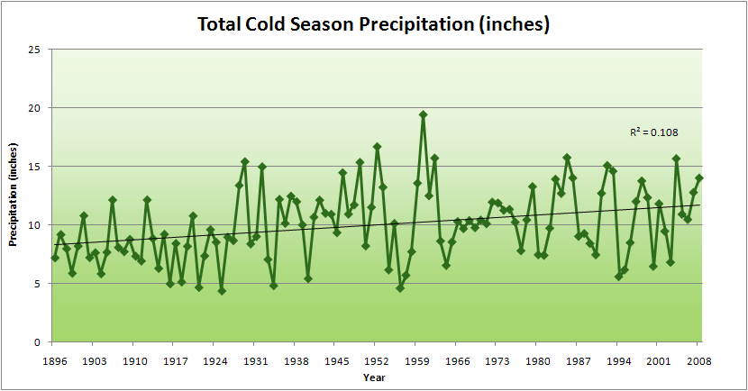
Cedar Rapids Data
51% increase
11.8”
7.8”

Slide 33
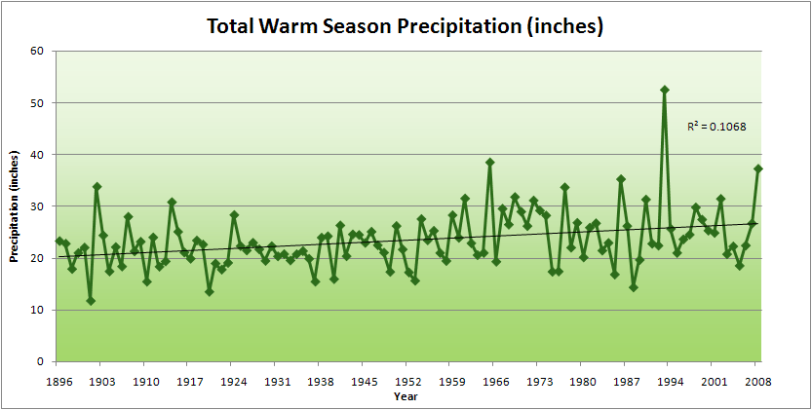
Cedar Rapids Data
34% increase
26.8”
20.2”

Slide 34
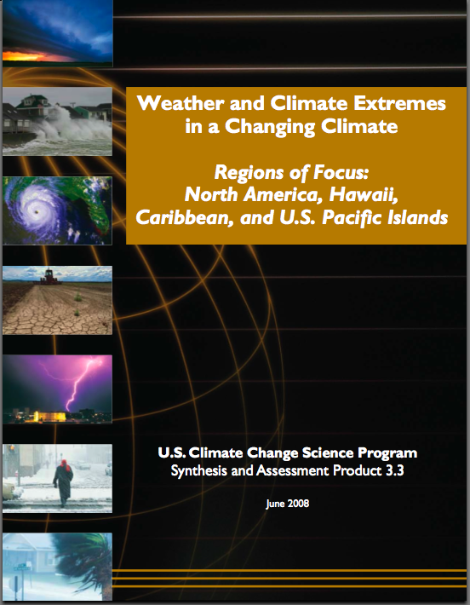
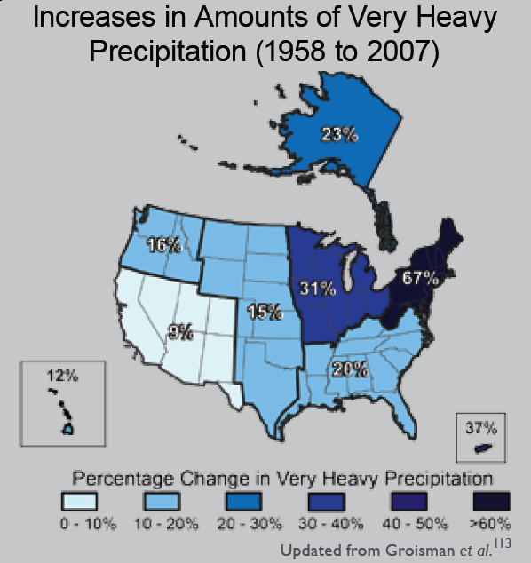
“One of the clearest trends in the United States observational record is an increasing frequency and intensity of heavy precipitation events… Over the last century there was a 50% increase in the frequency of days with precipitation over 101.6 mm (four inches) in the upper midwestern U.S.; this trend is statistically significant “
Karl, T. R., J. M. Melillo, and T. C. Peterson, (eds.), 2009: Global Climate Change Impacts in the United States. Cambridge University Press, 2009, 196pp.

Slide 35
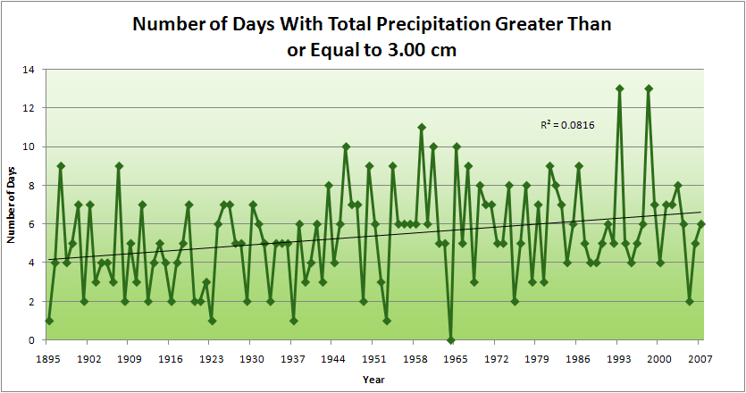
Cedar Rapids Data
4.2 days
57% increase
6.6 days

Slide 36
Cedar Rapids Data
Years having more than 8 days
11
2
4.2 days
57% increase
6.6 days

Slide 37
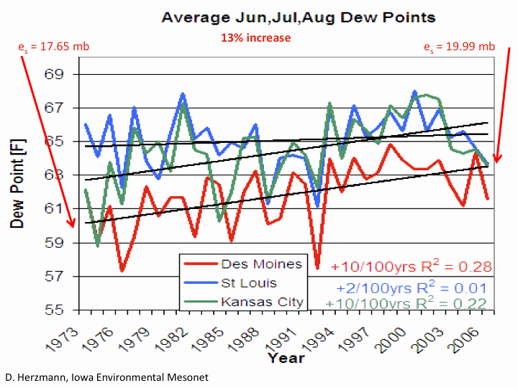

Slide 38
Iowa Agricultural Producers’ Adaptations to Climate Change
Longer growing season: plant earlier, plant longer season hybrids, harvest later
Wetter springs: larger machinery enables planting in smaller weather windows
More summer precipitation: higher planting densities for higher yields
Wetter springs and summers: more subsurface drainage tile is being installed, closer spacing, sloped surfaces
Fewer extreme heat events: higher planting densities, fewer pollination failures
Higher humidity: more spraying for pathogens favored by moist conditions. more problems with fall crop dry-down, wider bean heads for faster harvest due to shorter harvest period during the daytime.
Drier autumns: delay harvest to take advantage of natural dry-down conditions
HIGHER YIELDS!!
Is it genetics or climate? Likely some of each.

Slide 39
For More Information
Assessment of Potential Impacts of Climate Changes on Iowa
Using Current Trends and Future Projections
Eugene S. Takle
Climate Science Program
Iowa State University
Ames, IA 50011
gstakle@iastate.edu
515-294-9871
13 August 2010

Slide 40
Why Is Iowa Getting So Many Floods?

Slide 41
Why Small Changes in Rainfall Produce Much More Flooding
13% increase in atmospheric moisture in June-July-August
~10% increase in average precipitation in Iowa
~5-fold increase in high-precipitation events, mostly in June-July-August, that lead to runoff
Iowa rivers and watersheds are oriented NW-SE
Rainfall patterns turn from SW-NE in March-May to W-E or NW-SE in mid summer
More frequent floods are the result of one or more of the following
    More rain
    More intense rain events
    More rain in the summer
    Rainfall patterns more likely to align with streams and watersheds
    Streams amplify changes in precipitation by a factor of 2-4
AND: more subsurface drainage tile has been installed

Slide 42
For More Information
Contact me directly:
gstakle@iastate.edu
Current research on regional climate and climate change is being conducted at Iowa State University under the Regional Climate Modeling Laboratory
http://rcmlab.agron.iastate.edu/
North American Regional Climate Change Assessment Program
http://www.narccap.ucar.edu/
For current activities on the ISU campus, regionally and nationally relating to climate change see the Climate Science Initiative website:
http://climate.engineering.iastate.edu/
Or just Google Eugene Takle

